Slide 1
Network Security through Nmap and performing MITM attack using Bettercap
Sparsh Roy BCA (Section A )
Enrolment number:220160212005

Slide 2
Introduction
During the time period of 11/06/2024- 11/08/2024, I was a cybersecurity intern at Acmegrade.
Undergone an intensive training program followed by a hands-on project-based internship.
The project comprised of the use of pentesting tools as per today’s trend.
I was also preparing for my CEHV12(Certified Ethical Hacker ) certification Exam by EC Council and was able to get certified successfully.
I have also completed my CCNA(Cisco Certified Netowrk Asscociate ) 200-301 training during this time period as well

Slide 3
Objectives
Learn about the basics of cybersecurity terms
Understand the usage of the commonly used cybersecurity tools
Get insights about industrial application
Vulnerability assessment and penetration testing

Slide 4
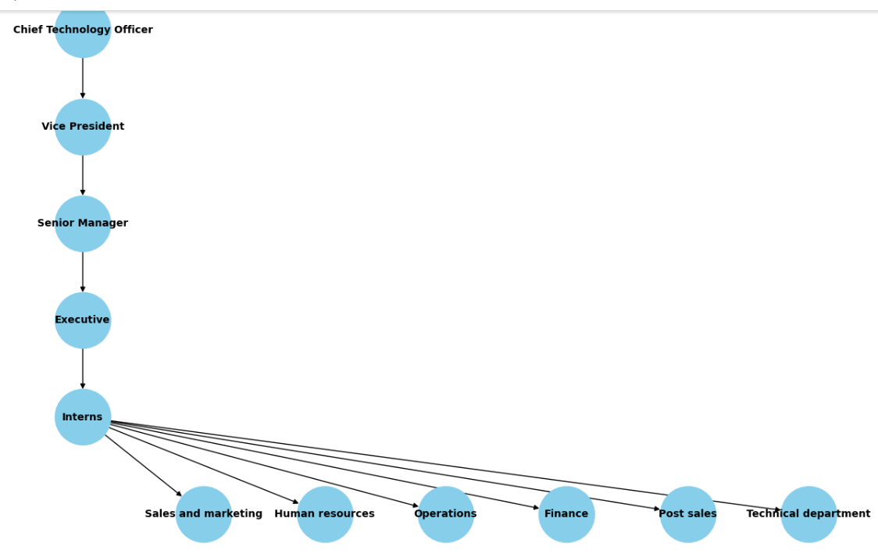
Organization Structure
The following flowchart shows the organization al structure of Acmegrade.

Slide 5
About Network security and MITM
Network security is defined as the activity created to protect the integrity of your network and data.
MITM generally occurs when an attacker is able to place himself in the middle of two other hosts that are communicating.
The attacker can observe all traffic before relaying it and modify or block it.
To the target host, it appears that communication is occurring normally since all expected replies are received.

Slide 6
Methodology
Kali Linux Nmap Scan- Nmap scanning is done on target machine for detecting services on open ports, detailed output,and detect target OS
Metasploit Setup- Use Metasploit(msfvconsole ) to use exploit Set payload, configure target and attacker IP and finally run exploit to gain meterpreter session .
Better cap for MITM- Start Bettercap, enabled network probing configured ARP spoofing to capture network traffic.
Pinged a site to generate traffic , then checked the ARP table on target.
Monitored system resources

Slide 7
Conclusions and Future Discussions
Conclusion
Nmap proved to be an invaluable tool for network discovery and vulnerability assessment, while Better cap effectively demonstrated various MITM attack techniques and allowed us to simulate real-world attacks.
Usage of these tools highlighted several potential vulnerabilities in network configurations and traffic management.
Future Discussions
Enhancing Security Measures
Expanding Tool Utilization
Training and Awareness Programs
Regular Audits and Reviews

